Slide 1

Smart Bank Assistant

Slide 2

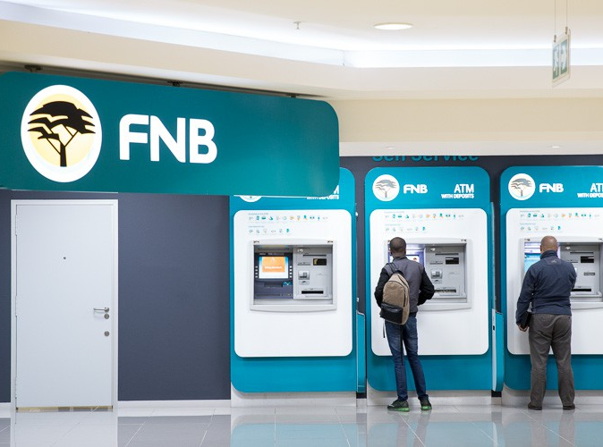
Agenda
Introduction
Problem Statement
Objectives of the Project
Technology Used
System Architecture
Features of Smart Bank Assistant
Project Modules
Advantages
Future Scope
Conclusion

Slide 3
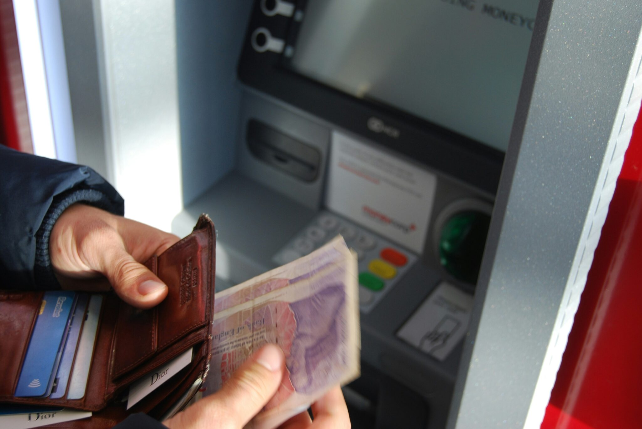
Introduction
•Smart Bank Assistant is a conversational AI chatbot.
•Built using IBM watsonx Assistant (Actions).
•Automates common banking services.
•Provides secure and structured customer interaction.

Slide 4
Objectives
•Provide 24/7 automated banking support.
•Collect customer input securely.
•Execute banking actions through structured flow.
•Improve customer experience.

Slide 5

Technology Used
•IBM Cloud
•watsonx Assistant
•Actions-based dialog design
•Variable-based information collection

Slide 6

Features Implemented
•Check Account Balance
•Transfer Money
•Mini Statement
•Block Card
•Update Mobile Number
•Loan Information
•Find Branch Location

Slide 7

Action Structure (IBM Terminology)
•Action Name
•Customer Starts With (Trigger phrases)
•Assistant Response
•Customer Response Type
•Variables
•Conditions & Next Step

Slide 8
Check Account Balance - Flow
•Step 1: Assistant asks for account number.
•Customer Response Type: Free Text
•Variable: account_number
•Privacy: Enabled
•Step 2: Assistant displays account balance.

Slide 9
Transfer Money - Flow
•Step 1: Collect account_number
•Step 2: Collect recipient_account
•Step 3: Collect transfer_amount (Number type)
•Step 4: Confirmation (Yes/No options)
•Condition-based final response.

Slide 10
System Architecture Diagram
User
IBM watsonx Assistant
(Actions Engine)
Banking System / Database

Slide 11
Future Scope
Voice assistant add kiya ja sakta hai
Mobile app integration
Secure login system
Real-time banking transactions

Slide 12
Advantages
Time saving
24/7 availability
Customer satisfaction improve hota hai
Bank staff ka workload kam hota hai

Slide 13
Conclusion
Smart Bank Assistant automates banking services.
Built using structured IBM Actions framework.
Secure variable handling and privacy enabled.
Scalable and integration-ready architecture.

Slide 14

Thank you

